Slide 1
BBPS
SUCCESS & FAILED
TRANSACTION

Slide 2
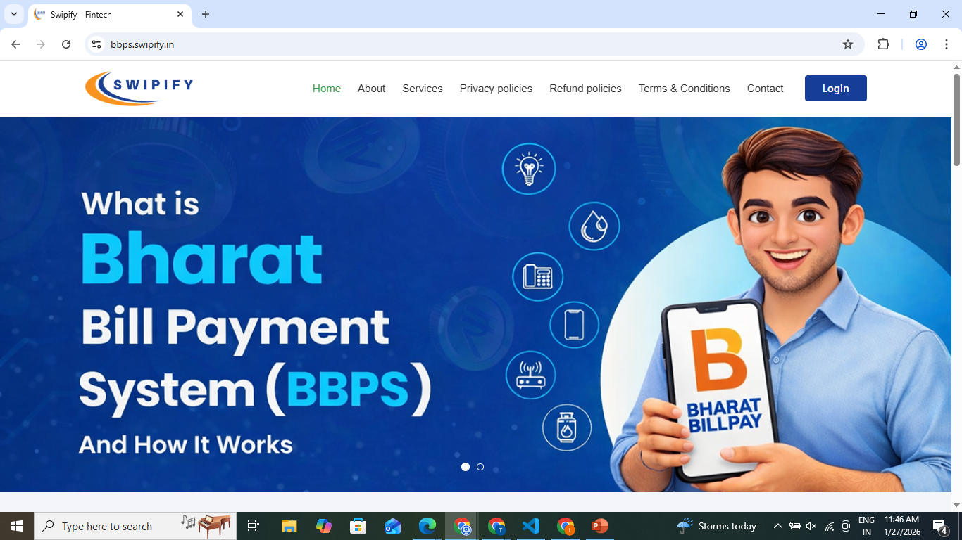
swipify – login page( https://bbps.swipify.in/ ) Step 1: Click on the Login button (top right of the page). Step 2: Enter your registered username and password, then click Submit to access your account.

Slide 3
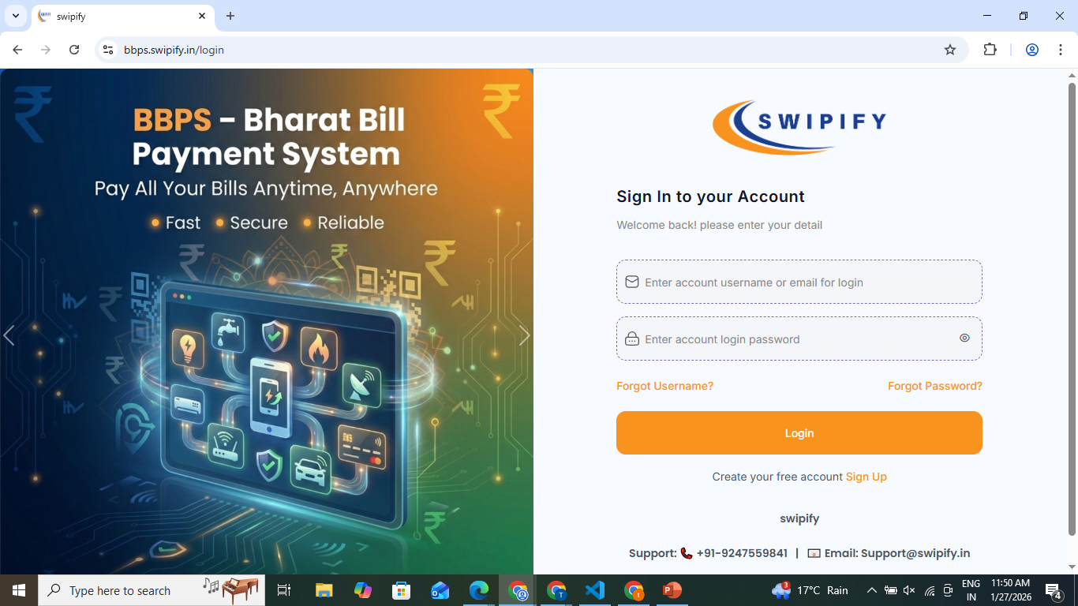
Login Page :- 1)-This page allows users to sign in to their account. 2)-User enters username/email and password to access the system.

Slide 4
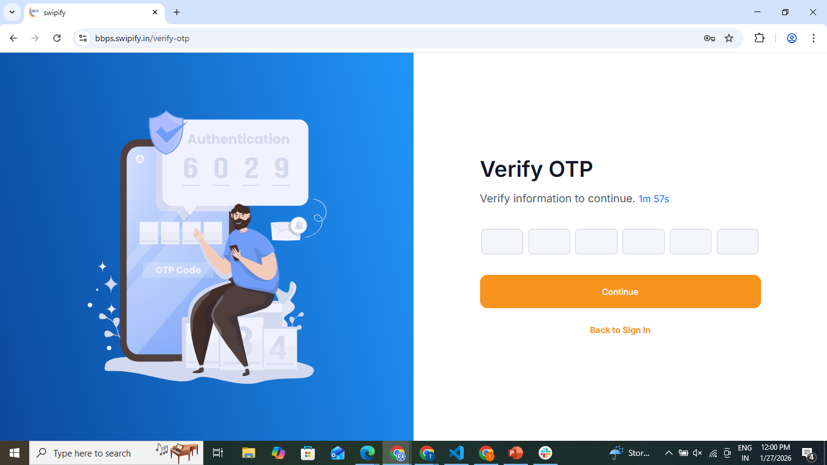
OTP Verification – Step 1: Enter the OTP received on your registered mobile/email in the given boxes. Step 2: Click Continue to verify and proceed further.

Slide 5
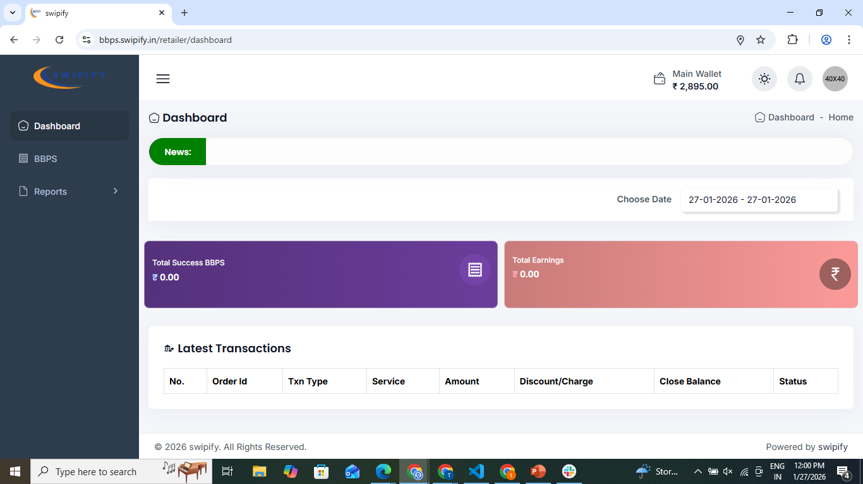
Dashboard – Step 1: After login, you land on the Dashboard where your wallet balance, earnings, and BBPS status are shown. Step 2: Check latest transactions and reports to track your daily activity.

Slide 6
For success transaction…

Slide 7
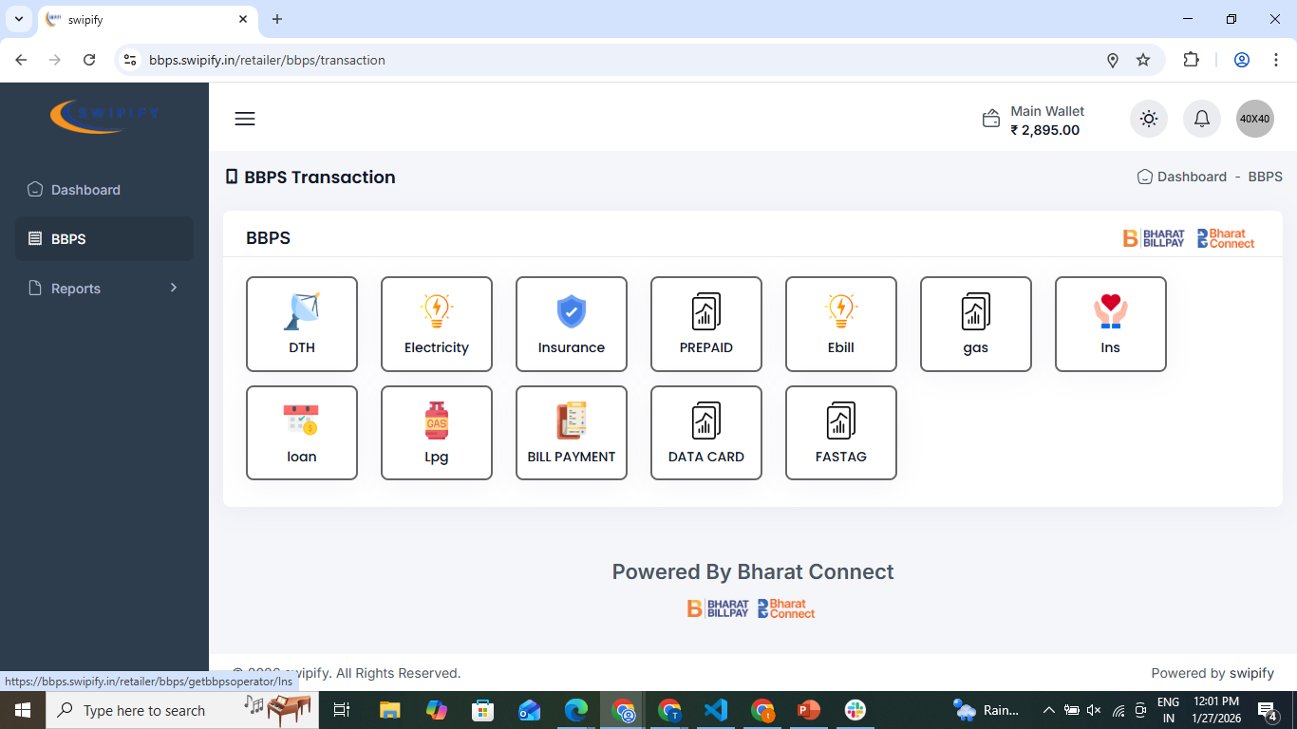
BBPS Transaction Page – Step 1: Select the bill/service type (Electricity, DTH, Gas, FASTag, Mobile, etc.). Step 2: Enter customer details and proceed to pay the bill.

Slide 8
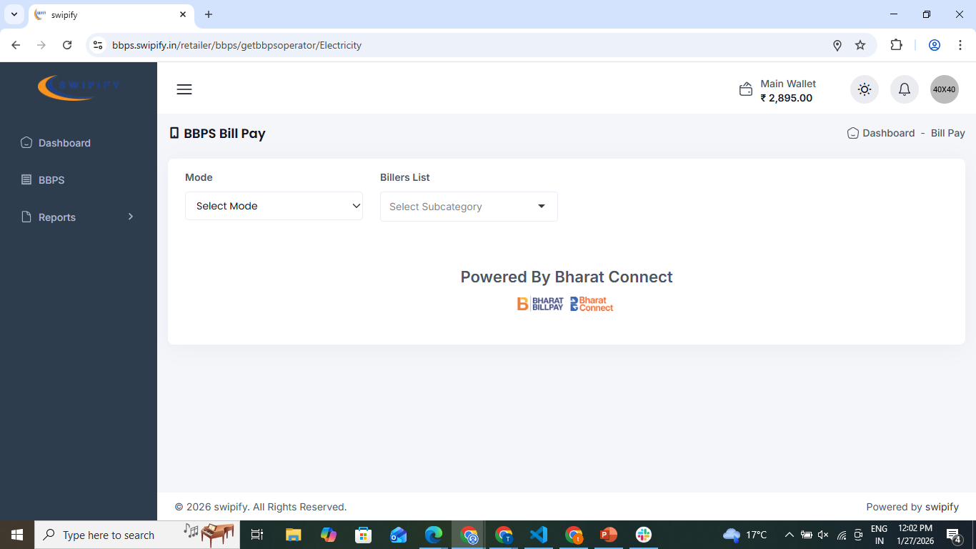
BBPS Bill Pay Page – Step 1: Select the Mode and choose the Biller/Subcategory (e.g. Electricity provider).

Slide 9
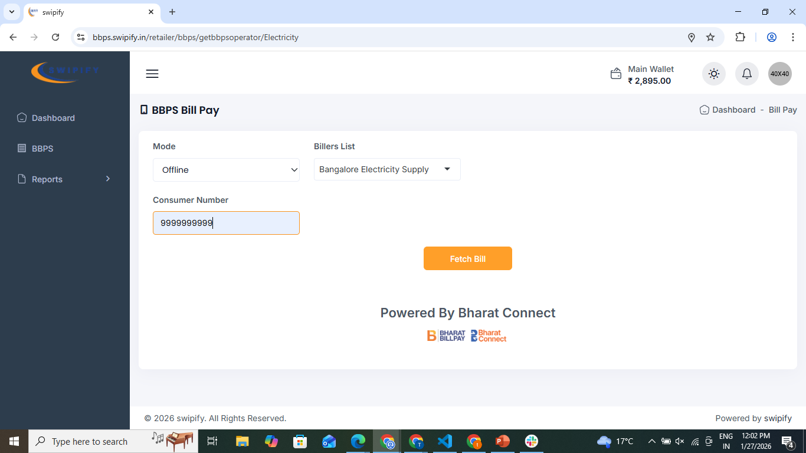
BBPS Bill Pay Page – success transaction. Step 1: Select the Mode and choose the Biller/Subcategory (e.g. Electricity provider). Step 2: Enter the ( 9999999999 ) to get the success transaction. Step 3: Enter the fetch bill to proceed.

Slide 10
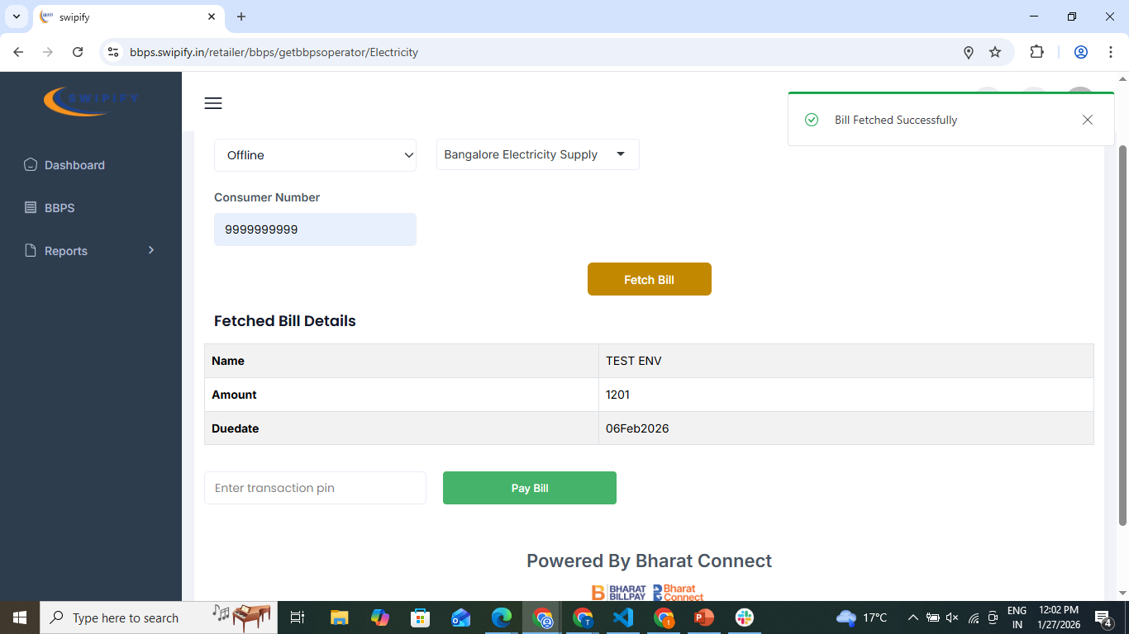
BBPS Bill Pay Page – success transaction. Step 1: In this page – successfully bill fetched.

Slide 11
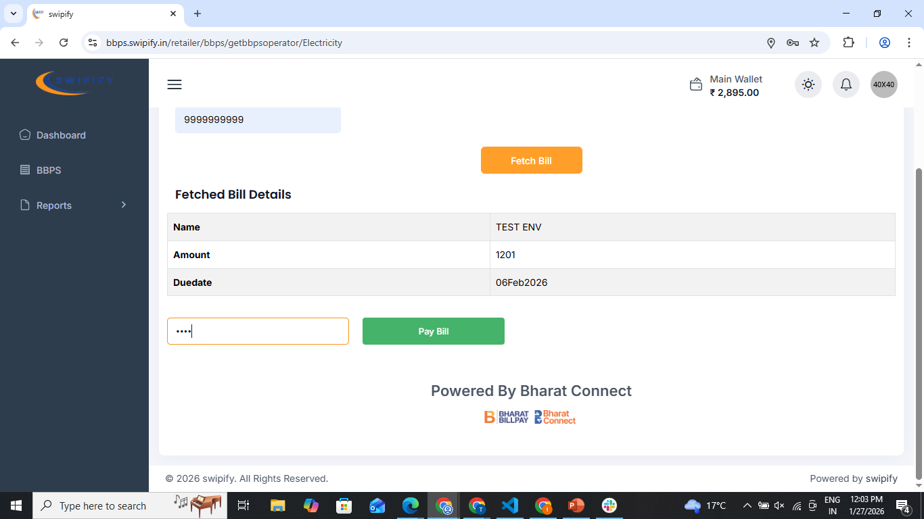
BBPS Bill Pay Page – success transaction. Step 1: After the fetch bill -- Step 2: Enter the transaction pin. Step 3: Enter the Pay bill to proceed the success transaction.

Slide 12
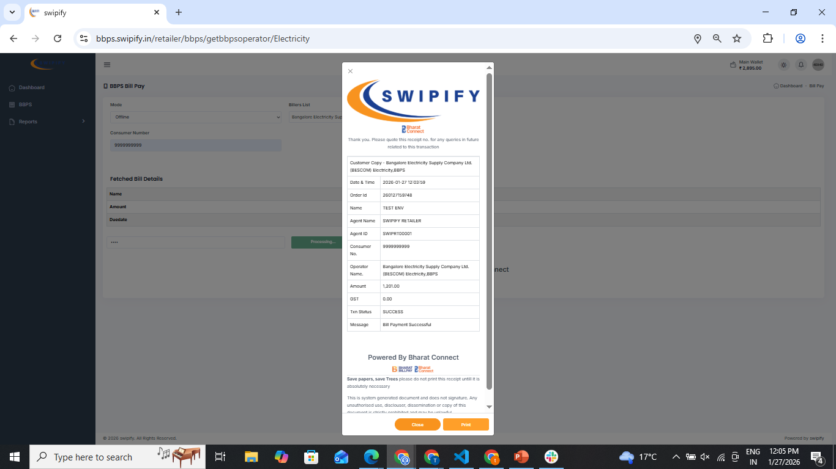
BBPS Bill Pay Page – success receipt Step 1: Complete a successful transaction, a receipt is generated showing the successful amount. Step 2: Click the Print button to print the receipt. Step 3: Click the Close button to exit the receipt.

Slide 13
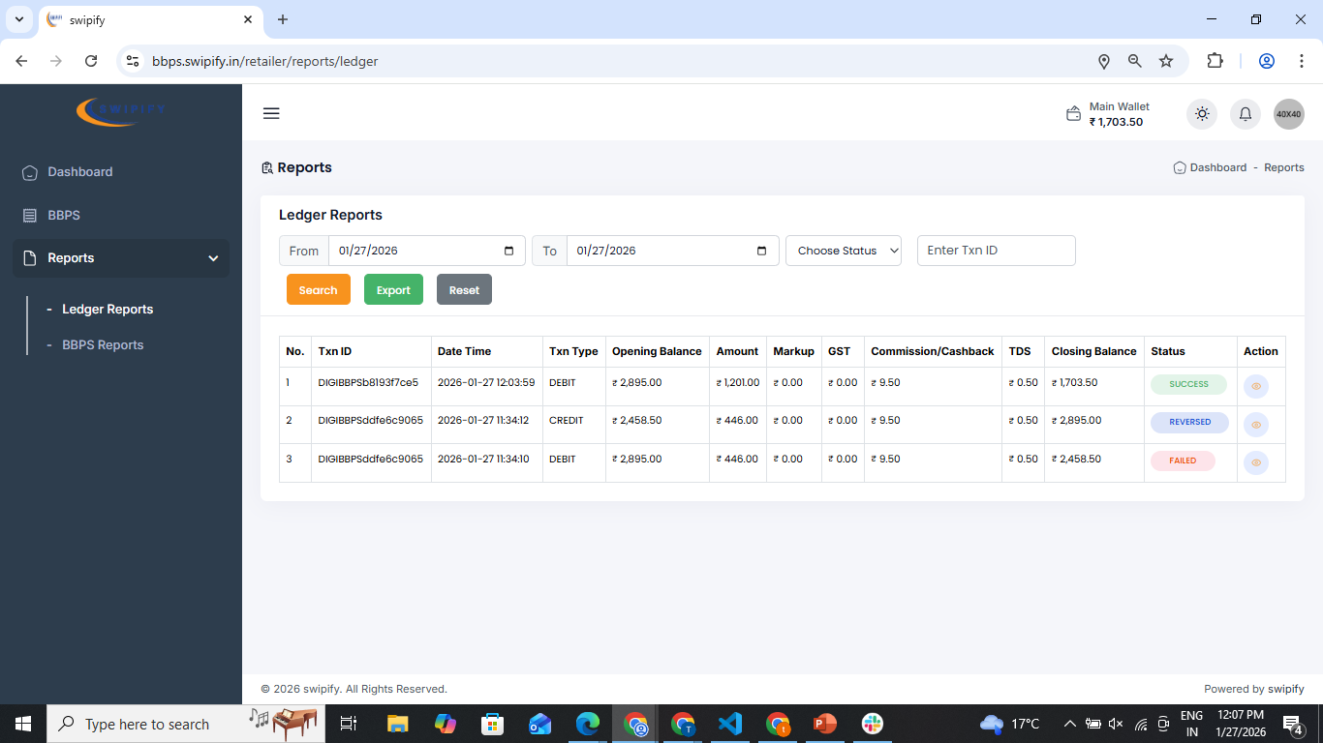
Ledger Reports Page – success transaction Step 1: Select date range, status, or transaction ID and click Search & Export to view records. Step 2: Review credits/debits, commission, TDS, and closing balance or Action to view transaction receipt.

Slide 14
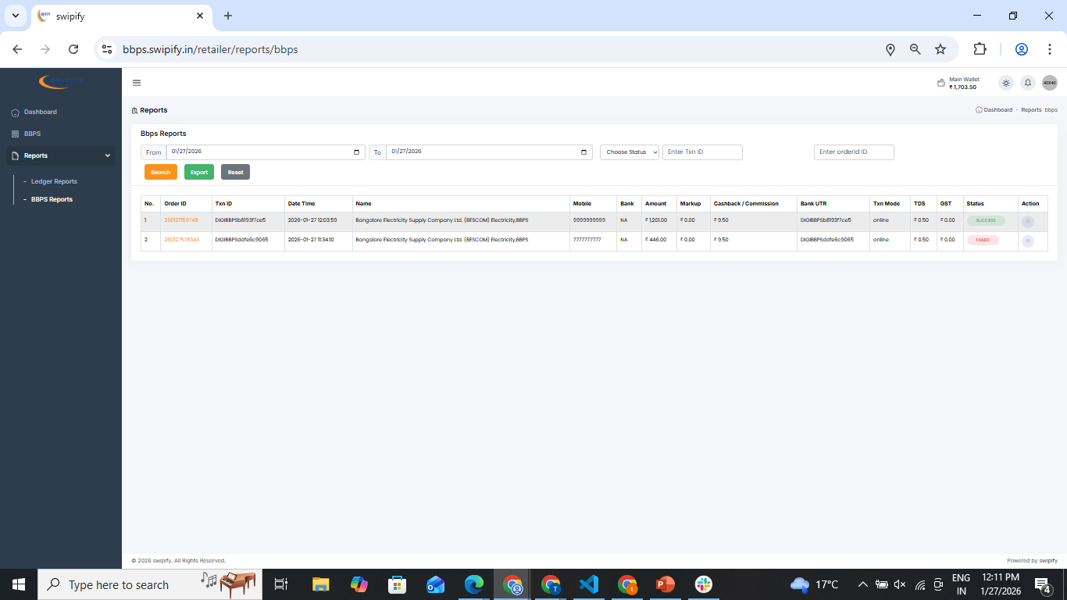
BBPS Report Page – success transction. Step 1: Select date range, status, or transaction ID and click Search & Export to view records. Step 2: Review Amount , commission , TDS, orderID and TxnID, or Action to view transaction receipt.

Slide 15
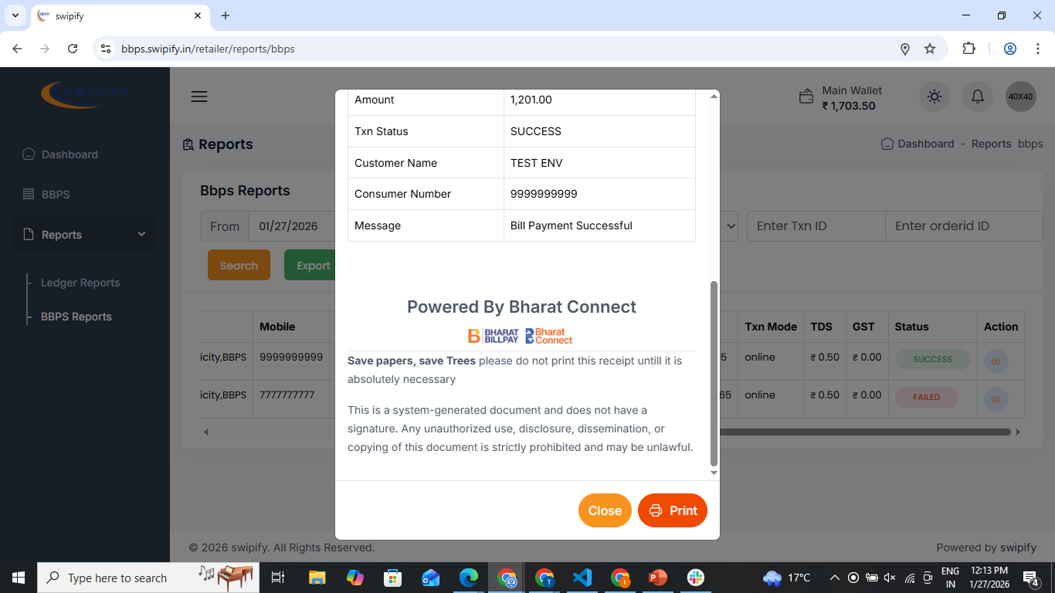
BBPS Report Page – success transaction. Step 1: Click on the Action button to view the transaction receipt. Step 2: Click Print to take a print of the transaction receipt. Step 3: Click Close to close the receipt.

Slide 16
For failed transaction…

Slide 17
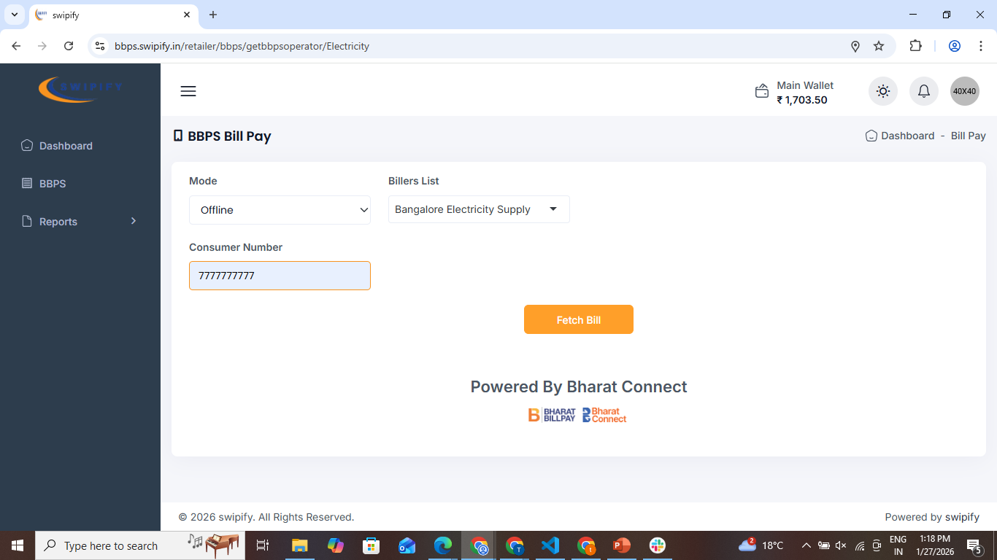
BBPS Bill Pay Page – Failed transaction. Step 1: Select the Mode and choose the Biller/Subcategory (e.g. Electricity provider). Step 2: Enter the ( 7777777777 ) to get the failed transaction. Step 3: Enter the fetch bill to proceed.

Slide 18
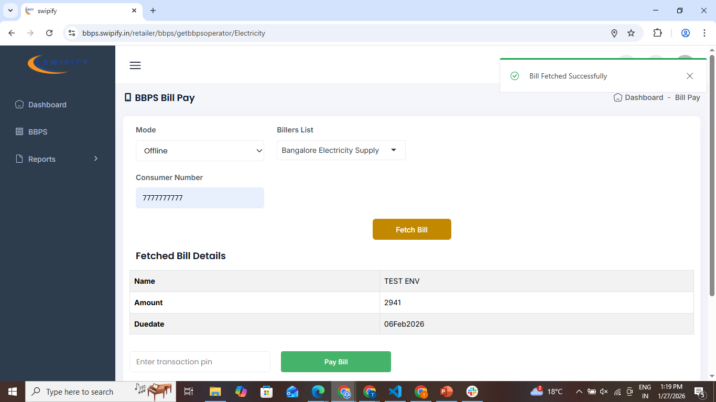
BBPS Bill Pay Page – Failed transaction. Step 1: In this page – successfully bill fetched.

Slide 19
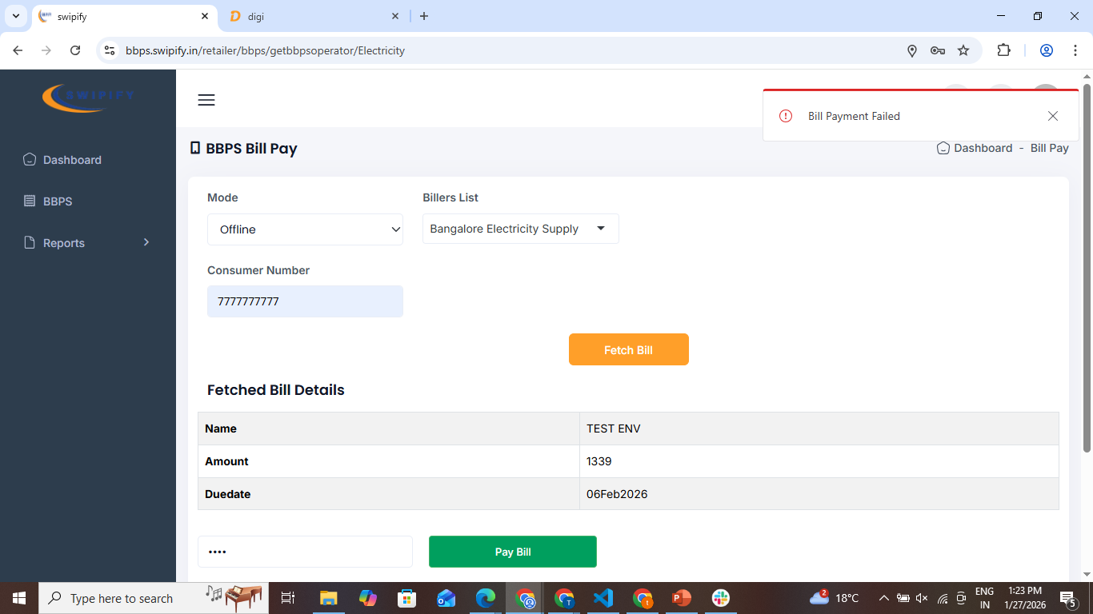
BBPS Bill Pay Page – Failed transaction. Step 1: After the fetch bill -- Step 2: Enter the transaction pin. Step 3: Enter the Pay bill to proceed the Failed transaction.

Slide 20
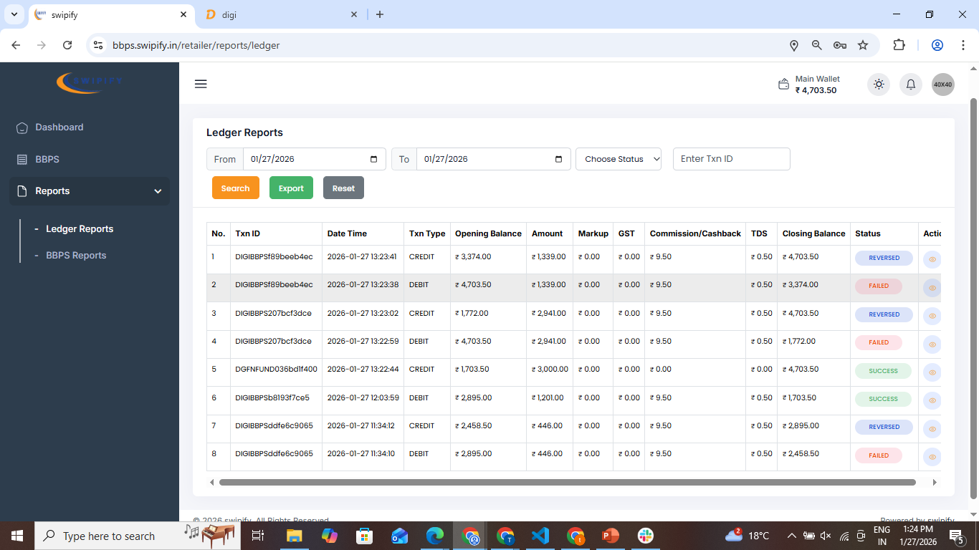
Ledger Reports Page – Failed transaction & Reversed . Step 1: Select date range, status, or transaction ID and click Search & Export to view records. Step 2: Review credits/debits, commission, TDS, and closing balance or Action to view transaction receipt.

Slide 21
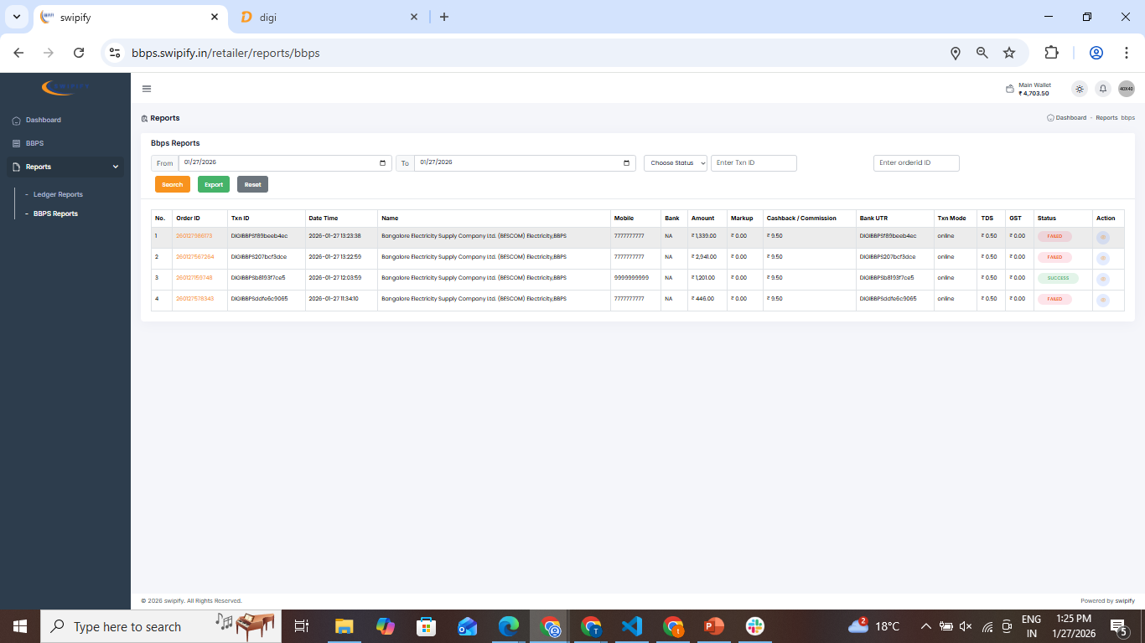
BBPS Report Page – Failed transaction. Step 1: Select date range, status, or transaction ID and click Search & Export to view records. Step 2: Review Amount , commission , TDS, orderID and TxnID, or Action to view transaction receipt.

Slide 22
Note – BBPS Transaction Testing… 1)-For a successful transaction, enter 9999999999 as the test number. 2)-For a failed transaction, enter 7777777777 as the test number.

